Slide 1

Open Enrollment 2021

Slide 2
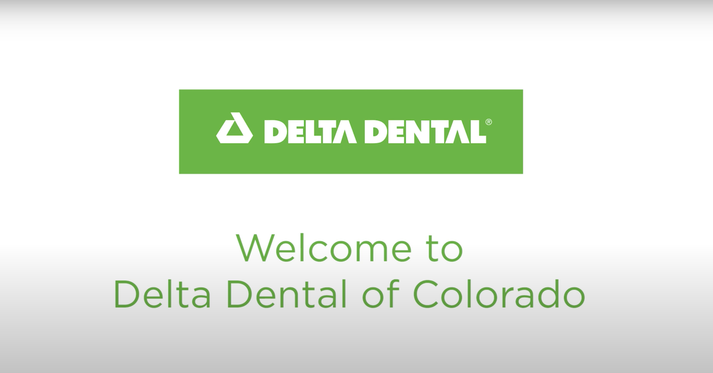
Notes:
Click on image in Slideshow to play video

Slide 3
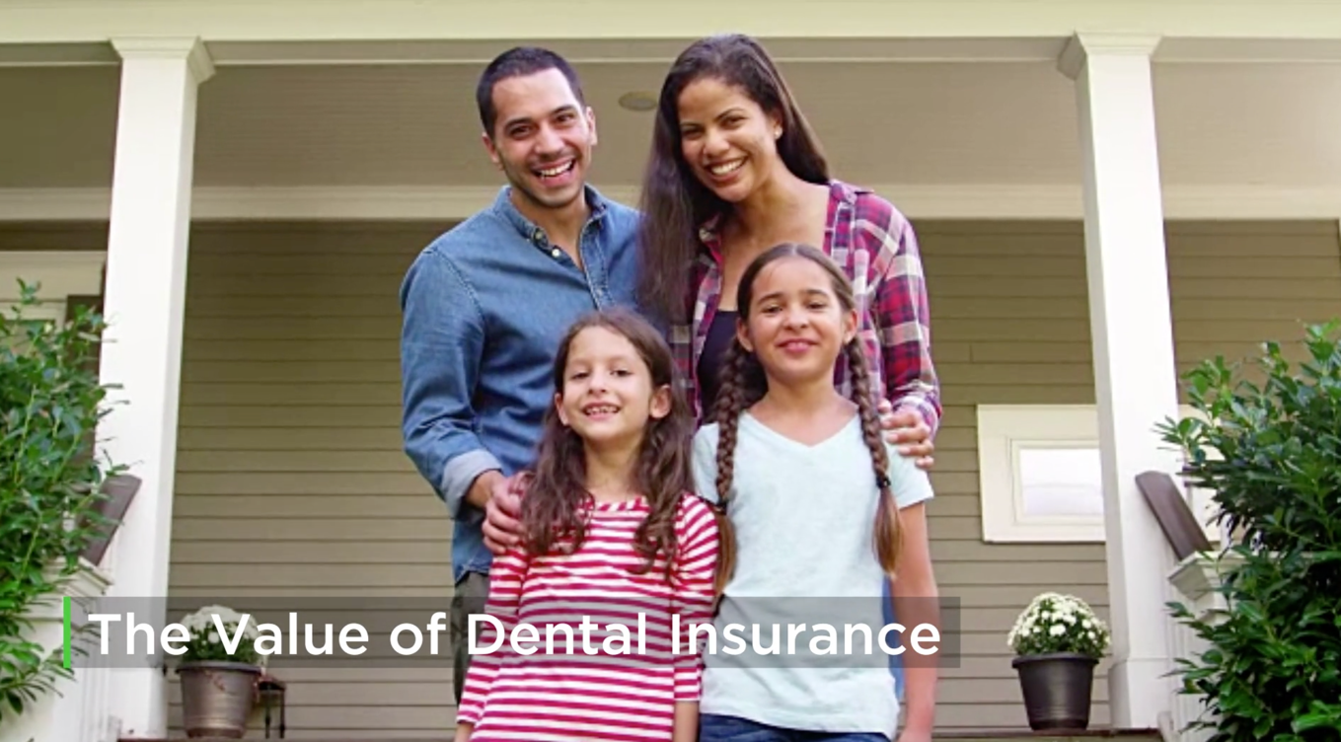
Notes:
Click on image in Slideshow to play video
https://www.youtube.com/watch?v=8IQ2j5GMn2A&feature=youtu.be

Slide 4
Two Networks Working Together
Which Delta Dental network is your dentist contracted with?
We have more than 3,500 Premier® providers and more than 2,500 PPO™ providers in Colorado.
Premier®
PPO™
More than 90% of all Colorado dentists are in our network, and 3 out of 4 dentists nationwide participate with us.
Notes:
About 90% of CO dentists are in one of our two networks, but as I mentioned earlier, you will achieve maximum savings by seeing a PPO provider. We have more than 155,000 dentists nationwide. That means 3 out of 4 dentists participate in the Delta Dental network.

Slide 5
Delta Dental’s Network
PPO Provider
Premier Provider
Non-Participating Provider
Online Tools
Reporting
No out-of-pocket costs savings due to discount
No balance-billing protection
You may have to submit your own claims to Delta Dental for reimbursement
Best out-of-pocket costs savings due to discount
Balance-billing protection
Smaller out-of-pocket costs savings due to discount
Balance-billing protection
Notes:
Delta Dental’s dual PPO and Premier network offers discounts off the cost of treatment and protection against balance-billing. There is no difference in quality between these two networks – only fee structures. A PPO provider will always save you the most in out-of-pocket costs. You will also save by seeing a Delta Dental Premier provider, but not as much as with a PPO provider. Non-participating providers have not agreed to any discounts with Delta Dental so you may be responsible for the entire difference between what the plan covers and what your provider has billed.

Slide 6
Best Value For Members
Using network dentists helps you save on out-of-pocket costs
 | Porcelain Crown
 | Delta Dental PPO™ | Delta Dental Premier® | Non-Participating (PPO Allowance Used)
Average Submitted Charge | $1,297 | $1,297 | $1,297
DDCO Contracted Allowance | $815 | $1,090 | $815*
Member Coinsurance | 50% | 50% | 50%
Balance Billed to Member (Submitted vs. Contracted fee) | $0.00 | $0.00 | $482
Total Member Cost (Balance Billed + Co-Share) | $407.50 | $545 | $889.50 ($407.50+$482)
* No contract exists for non-participating providers
Notes:
We have included an example to show you the differences between the three networks. As you can see on the bottom line, your cost increases significantly by going out of network, but you can save even more by getting services from a PPO provider.

Slide 7

Notes:
Oral health is connected to overall health. More than of all systemic diseases are linked to oral health.Poor oral health can lead to and escalate serious overall health issues. The mouth can serve as an important early-warning detection system for more than diseases and dentists and dental hygienists are powerful allies for your overall health and well-being.
Click on image in Slideshow to play video
https://www.youtube.com/watch?v=-1InAHcvFNk&feature=youtu.be

Slide 8

A New Online Experience
Easily manage your benefits on our website and member portal!
Notes:
Click on image in Slideshow to play video
https://www.youtube.com/watch?v=Tfe6yQApGrY

Slide 9

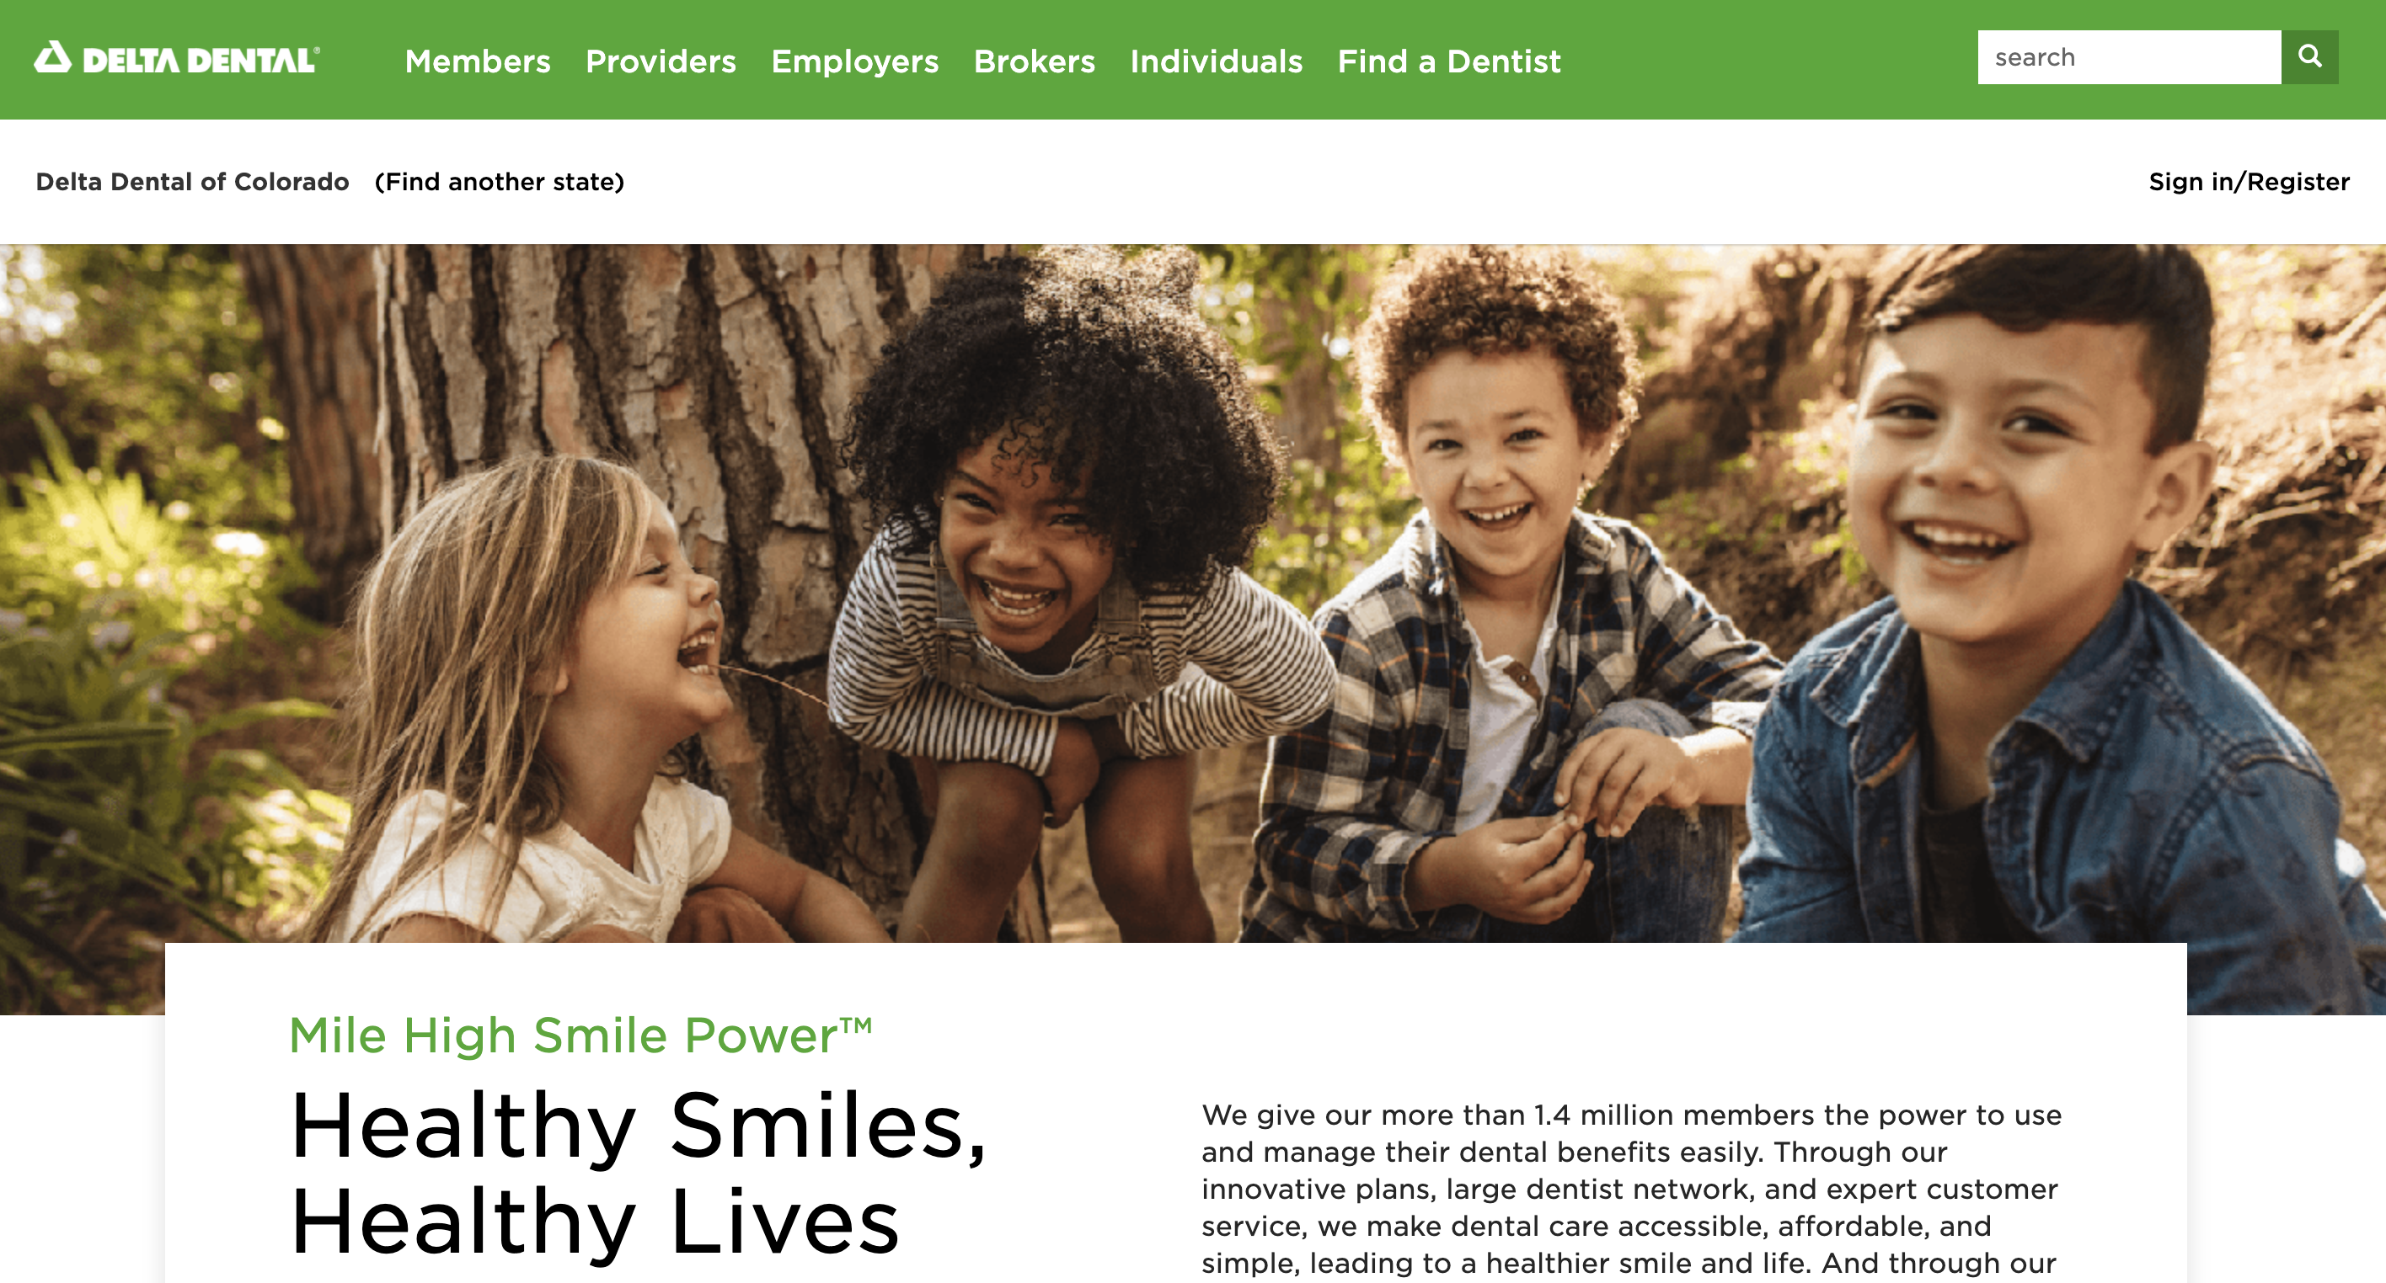
All the Information You Need
Online tools are available 24/7 at www.deltadentalco.com
Find a Dentist (ability to target search to PPO providers for deepest discount)
Oral health and wellness information
Benefit and Claim Updates
Notes:
We have many dental tools and lots of information on our website that can help you navigate your dental benefits and understand why a healthy mouth is important to your overall health. That website is www.deltadentalco.com.

Slide 10
How to Find a Dentist
Three easy ways to find a dentist
The Find a Dentist search tool at www.deltadentalco.com
Our free mobile app, available on iPhone and Android
Our customer service team at
customer_service@ddpco.com or 1-800-610-0201
Notes:
So you might be wondering how you find a PPO dentist…we have three ways to help you find a dentist near you. Our website, our mobile app, or by calling our customer service team.

Slide 11
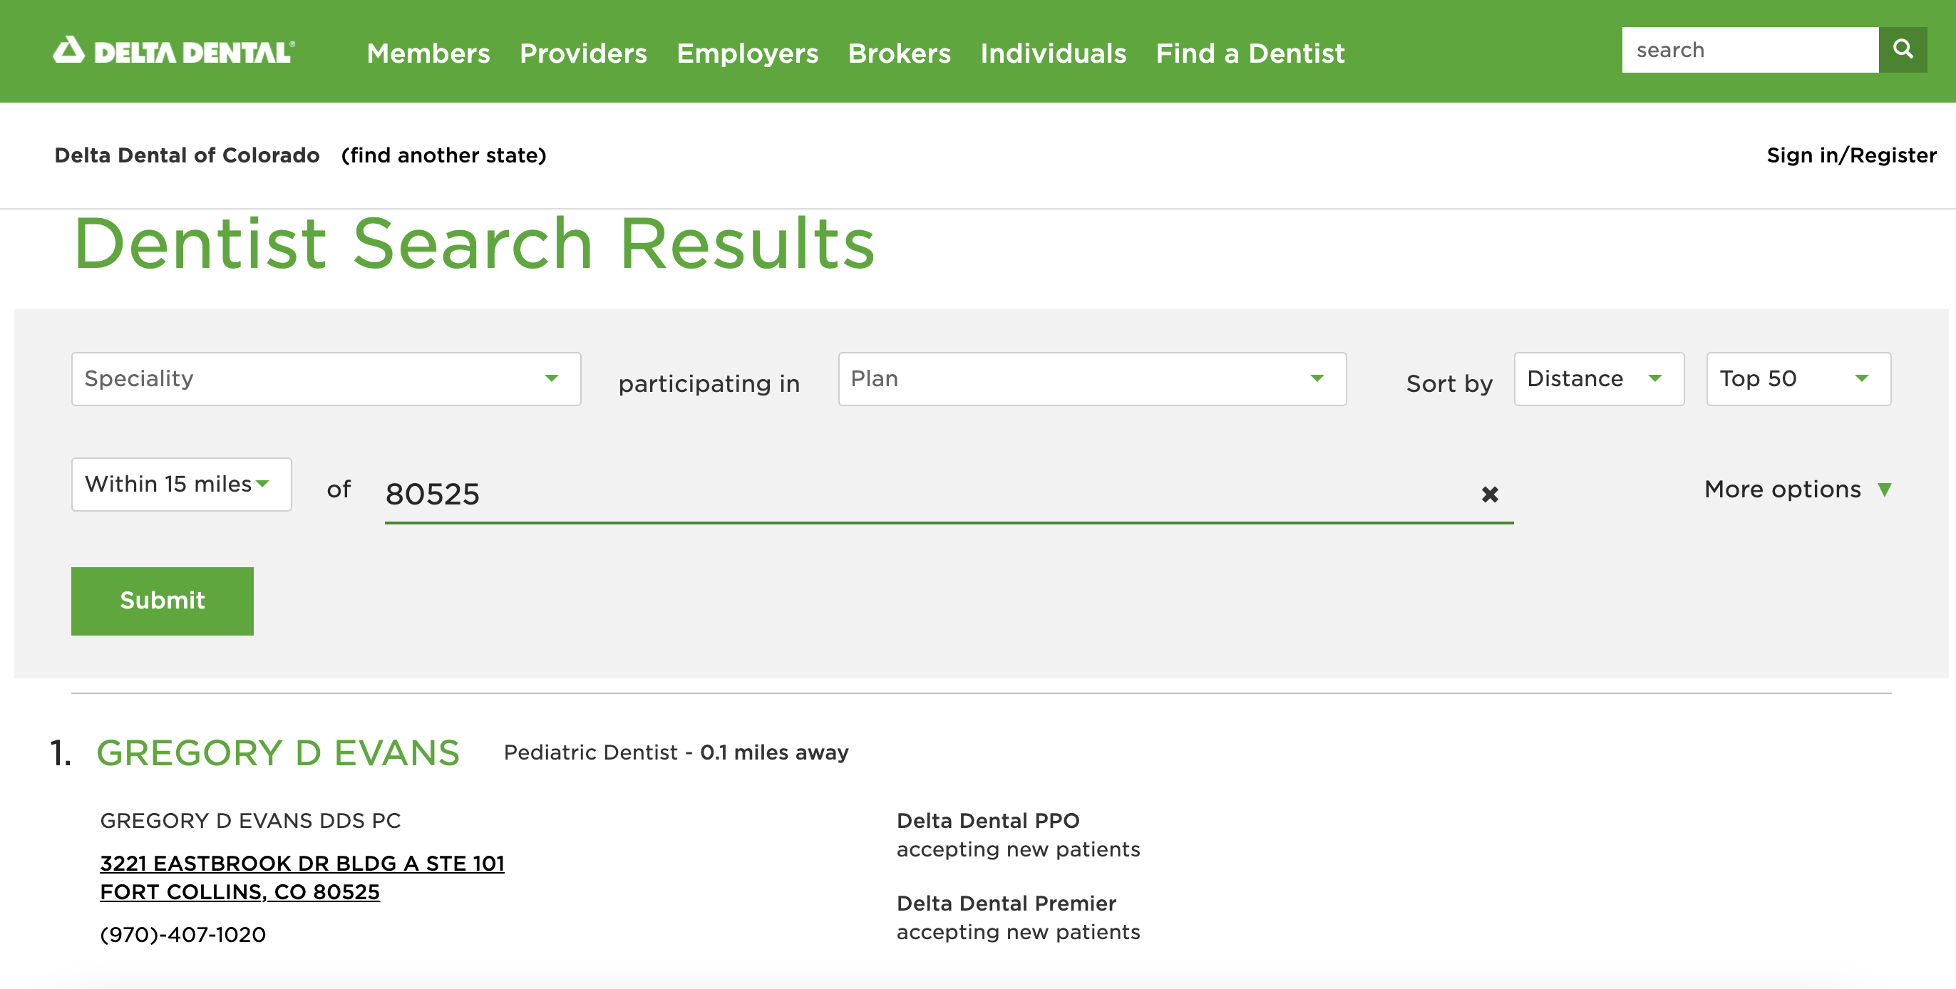
When You Find a Dentist
Which Delta Dental network does your dentist contract with?
Notes:
If you go to the website or the mobile app for support, you will see a display similar to the one shown here. If a provider accepts Premier only, you will see Delta Dental Premier listed, but not PPO. If you see both Delta Dental PPO and Premier listed, then the dentist agrees to bill you only up to their PPO fee schedule.

Slide 12
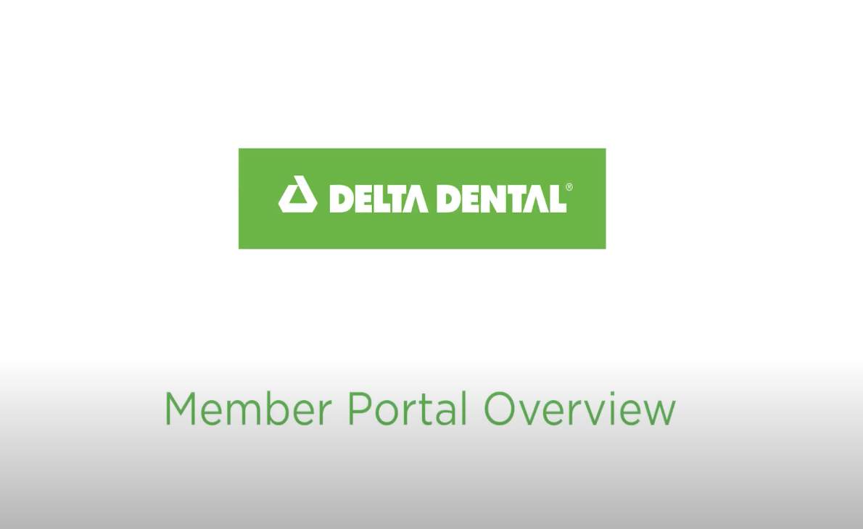
Notes:
Using our portal is simple and it’s the easiest way to gain access to your benefit information, claims, and more!
Click on image in Slideshow to play video
https://www.youtube.com/watch?v=A4YfsY0TBK8

Slide 13
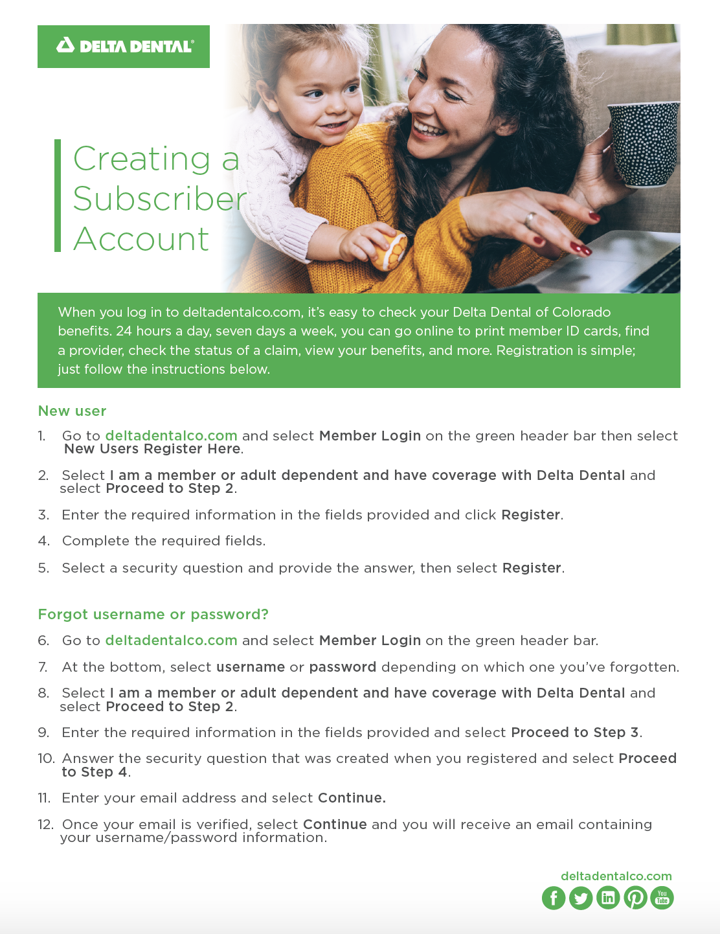
Create a Subscriber Account
Know what your benefits are to use them wisely
Check your benefits 24 hours a day, seven days a week
Print your member ID cards
Check status of a claim and view Explanation of Benefits
View your plan details and print a full Benefit Report
Get an idea of procedure costs with our Cost Estimator tool
Access your benefit information on the mobile app
Notes:
Creating a subscriber account can help you more easily manage your dental benefits. You will be able to check your benefits at any time, not just during normal business hours. While ID cards are not required, members can print an ID card, view their Explanation of Benefit (EOB) statement, or use our cost estimator tool that shows the average cost of certain services. We highly recommend that your dentist request a pre-determination of benefit for services that are expected to cost $400 or more.

Slide 14
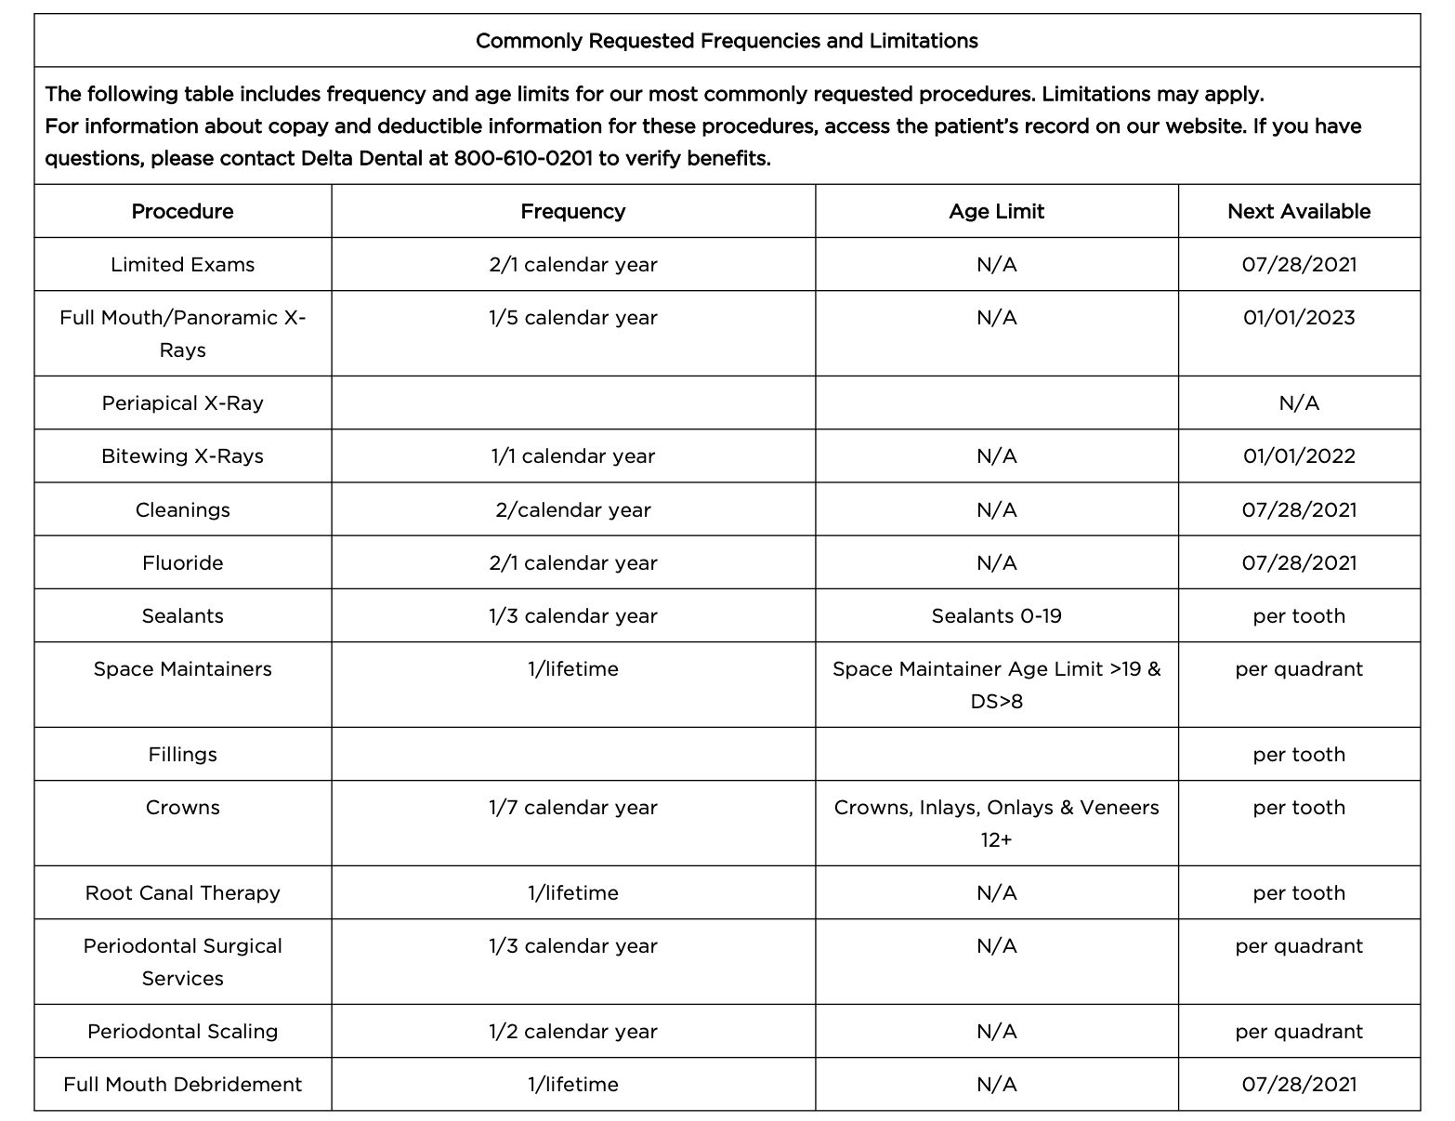
Benefit Report
Quick access to a full report of your benefits.
Notes:
Once you are logged in, you can download a full benefits report. This report provides a high-level overview of your coverage as well as the frequencies and age limitations for common services. This is a great report to bring with you when you go to the dentist, so you know if you are eligible for any recommended services.

Slide 15
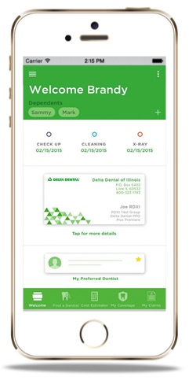
Mobile App
Create a subscriber account and access your benefits anywhere, anytime
Find a dentist
View benefits and claims
Mobile ID card – email to provider and dependents
Dental Care Cost estimator
Notes:
We all want access to information while we are on-the-go. Once you download the mobile app, you will have the ability to easily locate a dentist, view your ID card or claims, and much more.

Slide 16
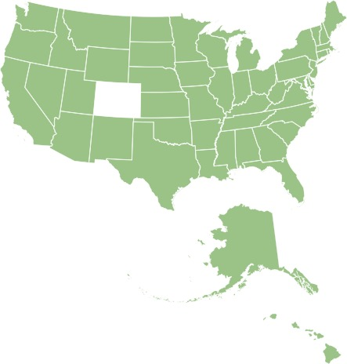
Local Service
Service you need when you need it…because we live where you live
Phone:
1-800-610-0201
Email:
customer_service@ddpco.com
Hours:
Monday–Friday
7:30 a.m.–5 p.m. MT
24/7 Automated Call Center
Notes:
We are located right here in Colorado – in the Denver Tech Center actually. Our customer service team is trained and ready to assist you with additional questions you have. You can reach them by phone Monday-Friday from 7:30 a.m. to 5 p.m. or by email as indicated.

Slide 17

Helping you unleash your Smile PowerTM

